Slide 1
What is Hacking ?
So what's the actual definition of hacking ?
“ Hacking is the process of finding vulnerabilities (bugs) in system, website or any object connected across internet and using these findings to gain unauthorised access to sensitive data to perform malicious activities ranging from deleting or stealing confidential data or information. “
So this is what actual hacking means but when someone reports these findings to the owner of that product or organization and help them to protect the systems and to resolve the vulnerabilities is known as ethical hacking.
Hello, Techies welcome to the world of one and zeroes, so before diving into the pool of tools and getting hands on practical let us understand some basic terms related to hacking.
So, What is Hacking basically ?
Now I think you have imagined the guy under hoodie with set-up of 2-3 monitors on desk, codes flowing from top to down an back forth on screen and keyboard clicks with lightening speed, Right! ?
Yea! You can call it, but its not the real definition is something else. You may not like someone with scrambled in wires fixing the code, some creepiest errors on screen and some failures on some operations or tasks. Trial and Errors are the main dark side of any successful hack, yea its bitter truth and dark side of any hack. But it not means that the world of hacking is only of errors, trials and failures its more interesting than you were thinking before. So are you ready to begin :o.

Slide 2
Being a Hacker!
While there is a thrill to hacking partly because of the illegal nature of computer trespass, we want to show you that it is just as big a thrill to alert others about lapses in security and make them public without worrying about going to jail over it. As a citizen of most countries, it is not only your right, but your responsibility, to report security and privacy leaks to the proper authorities. You do this not because you can, but because many other people can't. You are helping those who can't help themselves.. This is what you will learn to do. And this what how a good hacker should feel like
So, now I think you are ready with what actually Hacking is!
Then how it feels to be hacker ? Is it like feeling the master of tech world and why it should not be right! Because you are knowing how to break into systems and do other stuff like that. Let me clear you hacking is crucial activity and it needs creativity to break into systems without that you a are a bit away from it to fill that bit should think like devil and resolve like gods.
So how the hacker should be or good hacker should be ?

Slide 3
Types of Hackers
Now, you learned what is hacking and how a hacker should be. In this you will learn types of hackers
There are basically Three types of hackers the one who hacks for personal gains without reporting to anyone and try to fulfil needs by blackmailing we call them Black Hat hackers.
And the one who hacks to help and resolve the vulnerabilities by reporting normally woks for betterment we call them White Hat Hackers.
And the one who hacks for personal gains and even works for betterment of society by reporting we call them Grey Hat Hackers generally this type of hackers has both abilities of the two mentioned above.

Slide 4
Famous hackers
In this section you will see some of the famous hackers and how they become famous.
The hacker we are looking at are :-
Jonathon James
Kevin Mitnick
Mark Abene
Robert Morris
Gary McKinnon
Linus Torvalds

Slide 5
Famous Hackers
1. Jonathon James
2. Kevin Mitnick
Jonathan James was an American hacker. He is the first Juvenile who send to prison for cybercrime in the United States. He committed suicide on 18 May 2008, of a self-inflicted gunshot wound.
In 1999, at the age of 16, he gained access to several computers by breaking the password of a NASA server and stole the source code of International Space Station, including control of the temperature and humidity within the living space.
He is a computer security consultant, author, and hacker. He infiltrates his client's companies to expose their security strengths, weaknesses, and potential loopholes. In the history of the United state, he was formerly the most wanted computer criminal.
From the 1970s up until his last arrest in 1995, he skillfully bypassed corporate security safeguards and found his way into some of the most well-guarded systems like Sun Microsystems, Nokia, Motorola, Netcom, Digital Equipment Corporation.

Slide 6
Famous Hackers
3. Mark Abene
4. Robert Morris
Mark Abene is an American InfoSec expert and Entrepreneur. He is known around the world by his pseudonym Phiber Optik. Once, he was a member of the hacker groups Legion of Doom and Master of Deception. He was a high profile hacker in the 1980s and early 1990s.
He openly debated and defended the positive merits of ethical hacking as a beneficial tool for the industry. He is also expert in penetration studies, security policy review and generation, on-site security assessments, systems administration, and network management, among many others.
Robert Morris was the creator of the Morris Worm. He was the first computer worm to be unleashed on the Internet. The Morris Worm had the capability to slow down computers and make them no longer usable. Due to this, he was sentenced to three years probation, 400 hours of community service and also had to pay a penalty amount of $10,500.

Slide 7
Famous Hackers
5. Gary McKinnon
6. Linus Torvalds
Gary McKinnon is a Scottish systems administrator and Hacker. In 2002, he was accused of the "biggest military computer hack of all time". He has successfully hacked the network of Navy, Army, Air Force, NASA system of the United States Government.
In his statement to the media, he has often mentioned that his motivation was only to find evidence of UFOs and the suppression of "free energy" that could potentially be useful to the public.
Linus Torvalds is a American software engineer and one of the best hackers of all the time. He is the developer of the very popular Unix-based operating system called as Linux. Linux operating system is open source, and thousands of developers have contributed to its kernel. However, he remains the ultimate authority on what new code is incorporated into the standard Linux kernel.
Torvalds just aspire to be simple and have fun by making the world's best operating system. Linus Torvalds has received honorary doctorates from University of Helsinki and Stockholm University.

Slide 8
Fields in Hacking
Hacking is not a single field where you can dive into it, basically this is divided into many sub parts mainly
Web Application Penetration Testing (Websites)
Standalone App penetration testing (Android APP, IOS APP, Windows Programs)
You need to decide where you want to up-show your skills in this book we wil be going for Web Application Penetration Testing in this websites or web application are analysed for vulnerabilities and threats and how to overcome from those findings.
We recommend you to start your hacking career with Web Application penetration testing because this is where you will learn how to take over remote systems under control also widens you doors in hacking field and can bring you many more opportunities.

Slide 9
How to get started ?
Enough of introduction turn you off bit to on bit and let’s begin with prerequisites
Prerequisites
There are no special prerequisites you will need to get started, lets take a look what you’ll need –
1. A Computer System
2. Kali Linux Operating System installed ( Virtually or Dual Boot no Matters )
3. Internet Connection (optional but Recommended )
4.Linux Commands ( if you don’t need not worry you will learn in this course )
5. Patience
6. Hacker’s Mind-set (Devil’s Mind-set)
7. A Coffee ( if you like )

Slide 10
Linux Essentials
To use Linux and its Terminal or you can call it console uses commands to operate or function or you can call terminal, requires commands which is important to any hacker, don’t worry this commands are very easy to use and get your full control on operating system through Linux terminal. Terminal provides a powerful way of controlling operating system its much powerful than using it through GUI ( Graphical User Interface ) because you can direct has access to kernel or heart of operating system then doing with your GUI is wont possible. Now you know how muck powerful the Linux terminal is and hence it uses such commands to do so.
In this book you’ll learn some basic commands to get further in you hacking career which will go through performing some basic opertions and file handling and even networking commands.
Hacking can be done more convenient with Linux operating system that’s why kali Linux which is penetration and security distribution of Linux operating system is the choice of most hackers why ? It comes with all tools required for hacking preinstalled and the another reason the Linux rocks in hacking is, most of hacking tools are specifically designed for Linux operating system and are open source and even Linux is open source that means you can get the complete source code of operating system and can change according to your needs without obtaining any permissions to do so. In this book will be using kali Linux as our hacking system the reasons which I have mentioned above. In hacking you will mostly deal with terminal or console which looks like black window with borders and some text on it. This is your buddy or best friend that you should take with your hacking career, why ? You’ll understand it later.

Slide 11
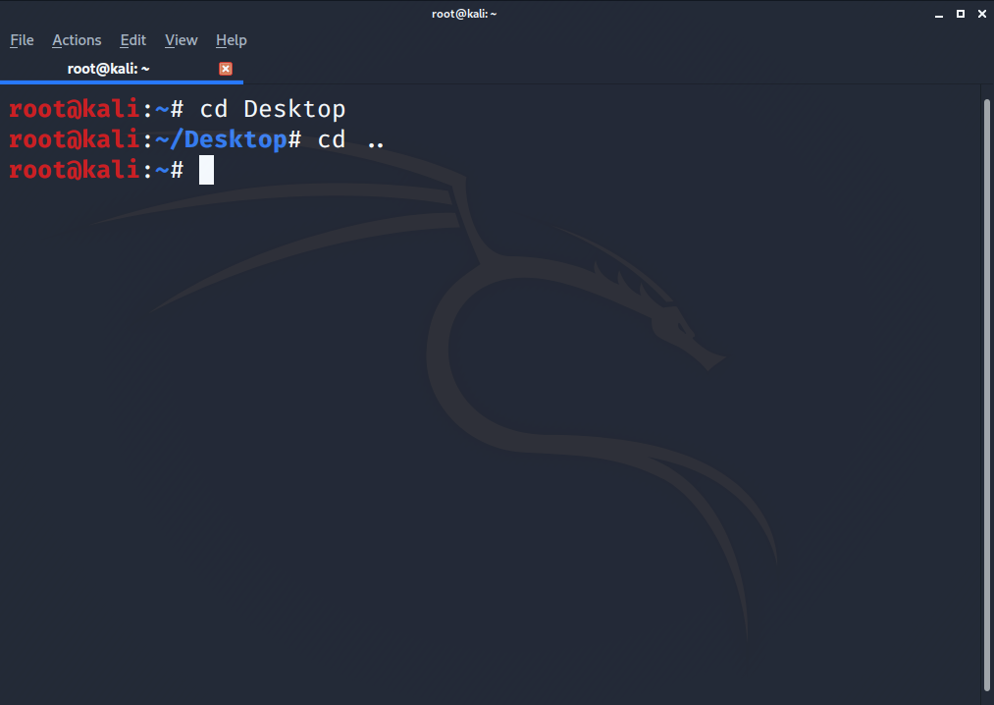
Linux Essentials
cd
The first command we’ll be seeing is cd command this stands for change directory command this helps to change the directory or folder from terminal. For example open your terminal your default path will be.
root@kali:~/#
If you want to change your directory to Desktop, just type
cd Desktop
And your directory will be changed to Desktop, note that Directory names and file names are case sensitive that means there is difference between desktop and Desktop. Now you can take a look at your path it will be changed to
root@kali:~/Desktop#
To go back to your default directory you need to just type
cd ..
This will take to you one directory level back, there is space between cd and ..
This is what the cd command used for. If you want more information regarding cd command just enter
cd –help this will print some basic information regarding the command and uses of it.
cd [ path ]

Slide 12
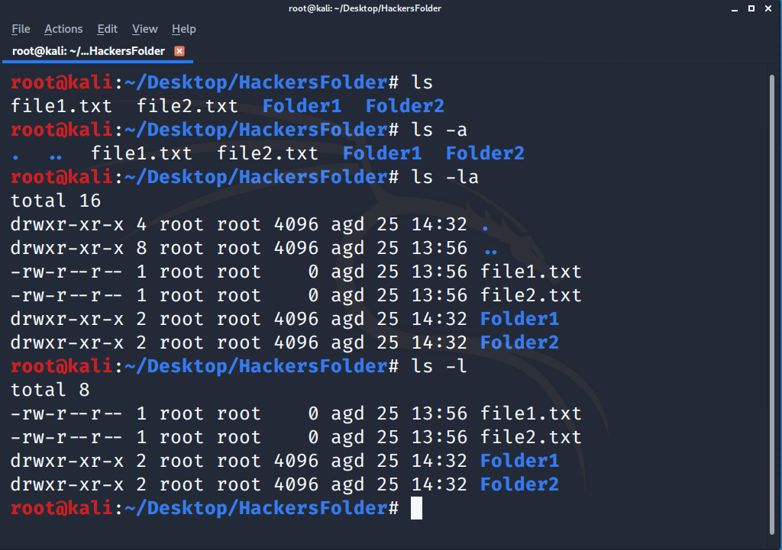
Linux Essentials
ls
The next command is ls command which is long listing which prints the files and directories present in that path or location.
If you type ls and press enter the lists of files and directories will be listed on console available at that location.
ls is not only an single command you can use, it also comes with some options like.
ls –a prints hidden files and folders.
ls –l prints list of files with their permissions and other details.
There are many options you can use and check out with
root@kali:~/# ls –help
Options –
-a
-l
ls [options]

Slide 13
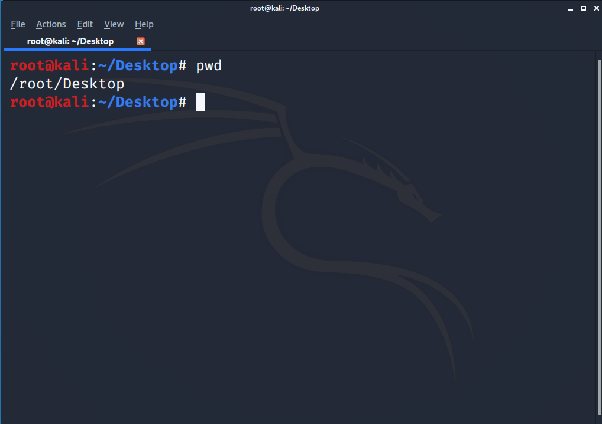
Linux Essentials
pwd
Next command is pwd , this is very basic and useful command this prints the current working directory and doesn’t deal with any kind of data.
For example
If enter pwd on console and press enter
root@kali:~/# pwd
/root/Desktop
It means you currently on Desktop

Slide 14
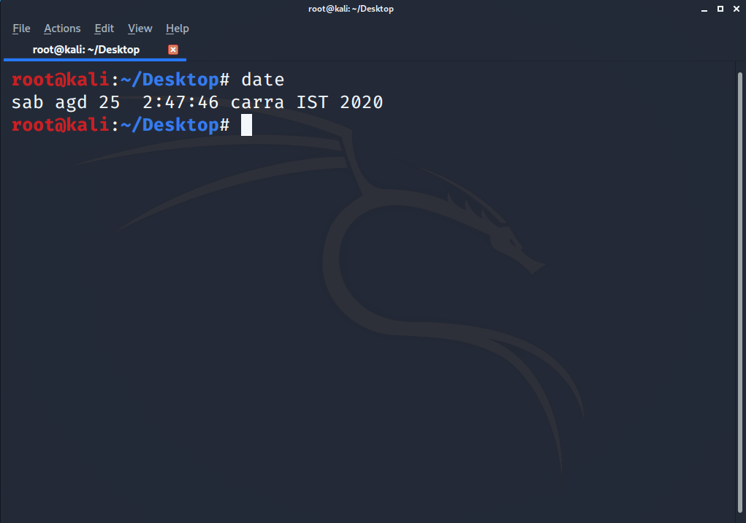
Linux Essentials
date
date command is use to print current date with time, it is an basic utility command.
For example
root@kali:~/# date
Fri, Apr 24, 2020 7:27:06 PM

Slide 15
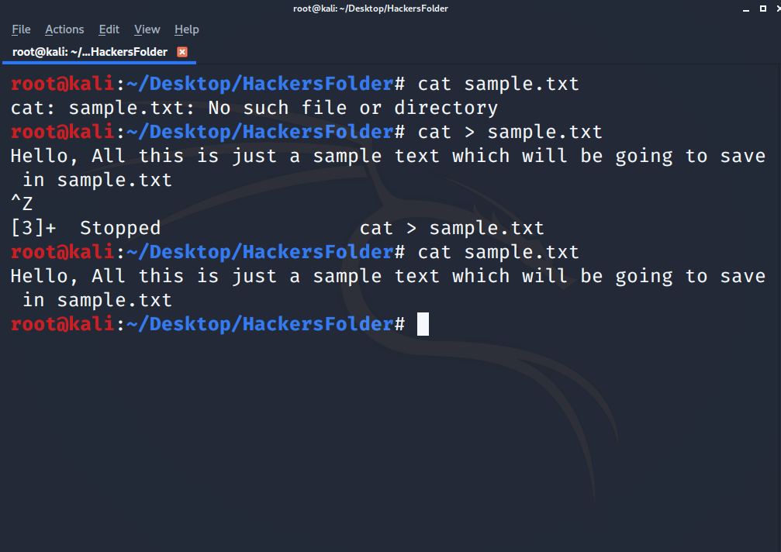
Linux Essentials
cat
cat command is file handling utility command. cat command is use to read the contents of file. It takes filename as parameter.
For example
For instance consider we have file named sample.txt in our desktop and we want to read its content directly from console to do so just type
root@kali:~/Desktop# cat sample.txt
Hey, there you are reading the contents of sample file.
If there is no file on that path it will prompt an error saying no such file.
cat is also use to create a file through console to do so enter
root@kali:~/Desktop# cat > filename.txt
This will create a file on that path.
> Symbol is use to create a file.

Slide 16
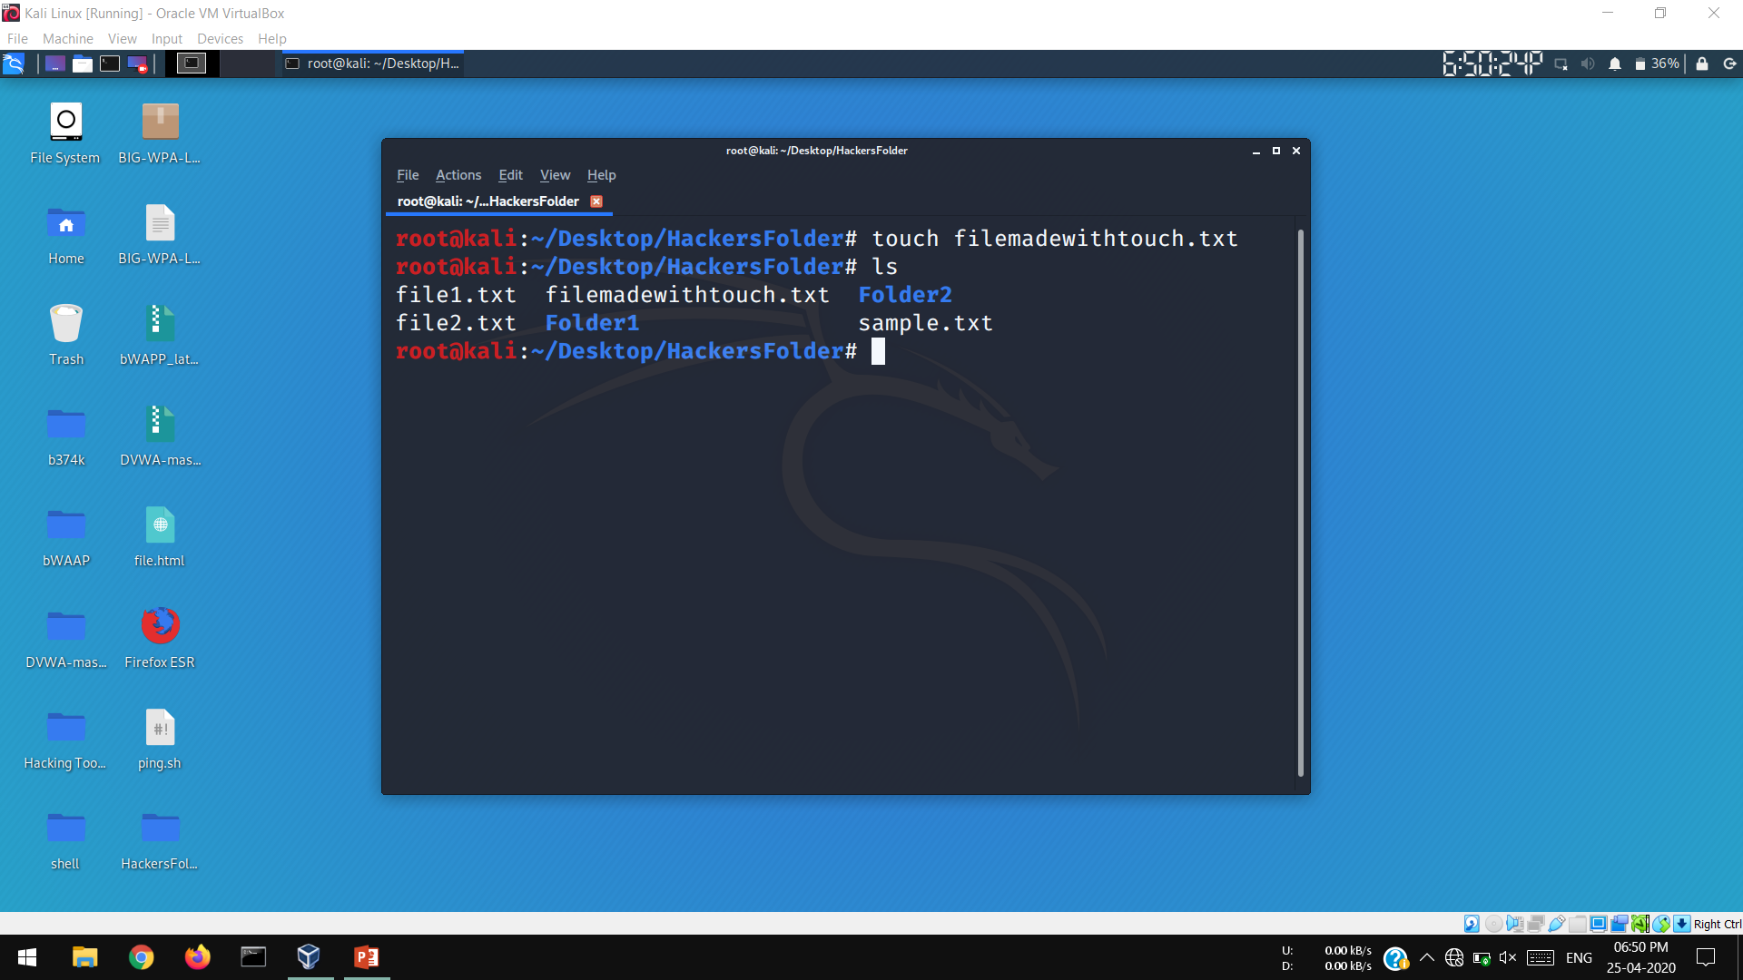
Linux Essentials
touch
cat is not a alone command which you can use to create a file but there are plenty in terminal which you can use. The another most popular is touch command which use to create a file. You can use touch as
root@kali:~/Desktop/HackersFolder# touch filename.txt
That’s it the file will be created, amazing right! There is more to go for just be in touch with this book.

Slide 17
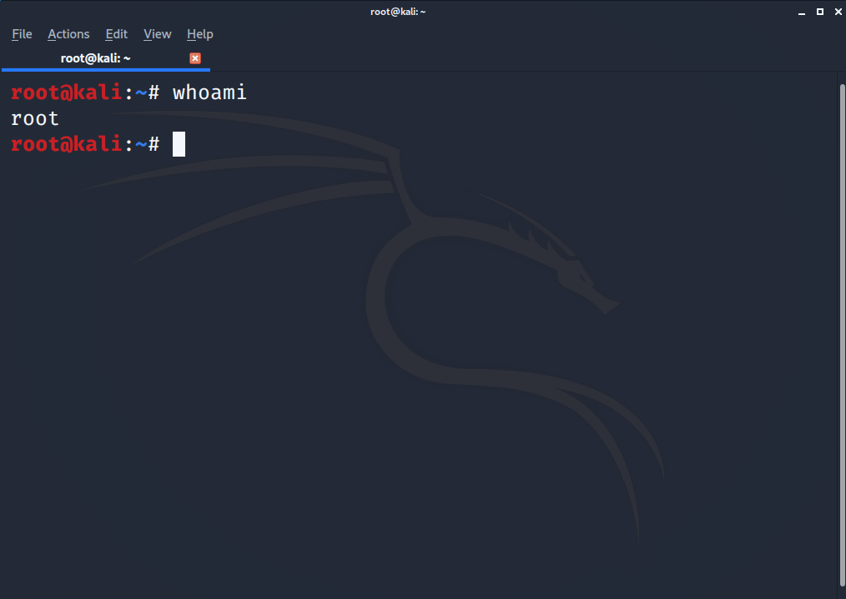
Linux Essentials
whoami
Next command is whoami which basically tells which user is operating the system or who you are.
If you enter
root@kali:~# whoami
In my case it tells
root
Because I’m using system as root or you can also a administrator like windows which has all the privileges..
If you are not a root user it will display the username you have logged with.
You can also get to know which user you are without entering any command by just looking at that symbol
If it is # then you are root user or else it will be displayed as @.
Such as
root@kali:~/# - root user
username@kali:/@ - normal user
Here root changes to your username too if you are not a root user.

Slide 18
Wi-Fi Hacking
Now, you have come through some basic Linux commands which will be very helpful and guide through this hacking course. Now we have reached to the most exciting part of this book which is practical, now I no you have been waiting for it through contents so lets get started with Wi-Fi hacking. Now Wi-Fi hacking cannot be done only with terminal or it some commands it uses some special programs or tools do that and in this you will be seeing two methods to crack Wi-Fi password the with terminal and other with GUI based application and we will be seeing which one is more reliable and convenient.
The tools which we are going to use are aircrack-ng and fern Wi-Fi hacker which are console and GUI based respectively, so before that let know some basic information regarding this tools and what have common in them.

Slide 19
Wi-Fi hacking
Aircrack-ng
While there is a thrill to hacking partly because of the illegal nature of computer trespass, we want to show you that it is just as big a thrill to alert others about lapses in security and make them public without worrying about going to jail over it. As a citizen of most countries, it is not only your right, but your responsibility, to report security and privacy leaks to the proper authorities. You do this not because you can, but because many other people can't. You are helping those who can't help themselves.. This is what you will learn to do. And this what how a good hacker should feel like
So, now I think you are ready with what actually Hacking is!
Then how it feels to be hacker ? Is it like feeling the master of tech world and why it should not be right! Because you are knowing how to break into systems and do other stuff like that. Let me clear you hacking is crucial activity and it needs creativity to break into systems without that you a are a bit away from it to fill that bit should think like devil and resolve like gods.
So how the hacker should be or good hacker should be ?

Slide 20
Wi-Fi hacking
Hack Wi-Fi
While there is a thrill to hacking partly because of the illegal nature of computer trespass, we want to show you that it is just as big a thrill to alert others about lapses in security and make them public without worrying about going to jail over it. As a citizen of most countries, it is not only your right, but your responsibility, to report security and privacy leaks to the proper authorities. You do this not because you can, but because many other people can't. You are helping those who can't help themselves.. This is what you will learn to do. And this what how a good hacker should feel like
The first step to hack the Wi-Fi is to turn on our Wi-Fi card or interface into monitor mode which is also called promiscuous mode which enables it see all the traffic on target which can’t be possible on normal mode. For those who don’t get what is monitor mode just assume that we are enabling the hidden powers of our Wi-Fi interface card, Which helps in cracking Wi-Fi keys, before that we need to run some extra commands to ensure that monitor mode should enable easily without getting into issues this is necessary because some background process can put it into some issues, the commands are,
$ sudo airmon-ng check kill
to enable the monitor mode enter following command.
$sudo airmon-ng start wlan0

Slide 21
WEB Defacement
Now, you have came across how to hack Wi-Fi passwords and that’s amazing right and very inetrsting to know that you can crack any Wi-Fi passwords and what are the requirements of Wi-Fi to hack, but don’t go on hacking public Wi-Fi keys that’s illegal without obtaining written permissions, and any think done wrong we will not hold any responsibility for any loss or damage neither this book holds any responsibility.
so in this next chapter we will be looking how to penetrate the web application or website, in this we will hack that whole server means we will take the full control of that host server hosting website, we will retrieve database values and also explore some hidden files which are not usually offered by web developers to explore for normal users. Note that we are not targeting any live real website hosted on google or yahoo or any kind or search engine, we will setup our own website on our local machine by this we will not need to worry of any thing gone wrong any need to obtain any kind of permission, so lets get started with doing.
WARNING – this tutorial is only provided with the means of knowledge and tech safety awareness, I’ll not be responsible for any you done outside of safety barriers, take this in consideration.

Slide 22
WEB Defacement
Setting up Lab
In this we are setting our website locally or on our personal computer, to setup our own website we need to understand some terms related oh hosting. Normally website hosting requires three main important services which are first is website, second is Server software which provides service to host our website and explore it and the third is database service for storing web data in server.
Here we are using Apache server which is software which enables to host our websites and which comes preinstalled on kali Linux distribution, and MySQL database service which again comes with preinstalled in Kali Linux. I’ll go considering you know some basics regarding what is MySQL and how it stores the data. If you don’t, no worry just do follow me along with how I’m doing you will get to understand. Then next we will need is website which we are not designing anymore we will download this website which are offered many resources and which are specially designs to get hacked or perform hacking operations. The website we are setting is bWAPP which stands for Buggy Web Application. As its name says its extremely buggy and can easily hacked.
Here is the download link go ahead and download it first.
https://www.bwaap.com/downloads

Slide 23
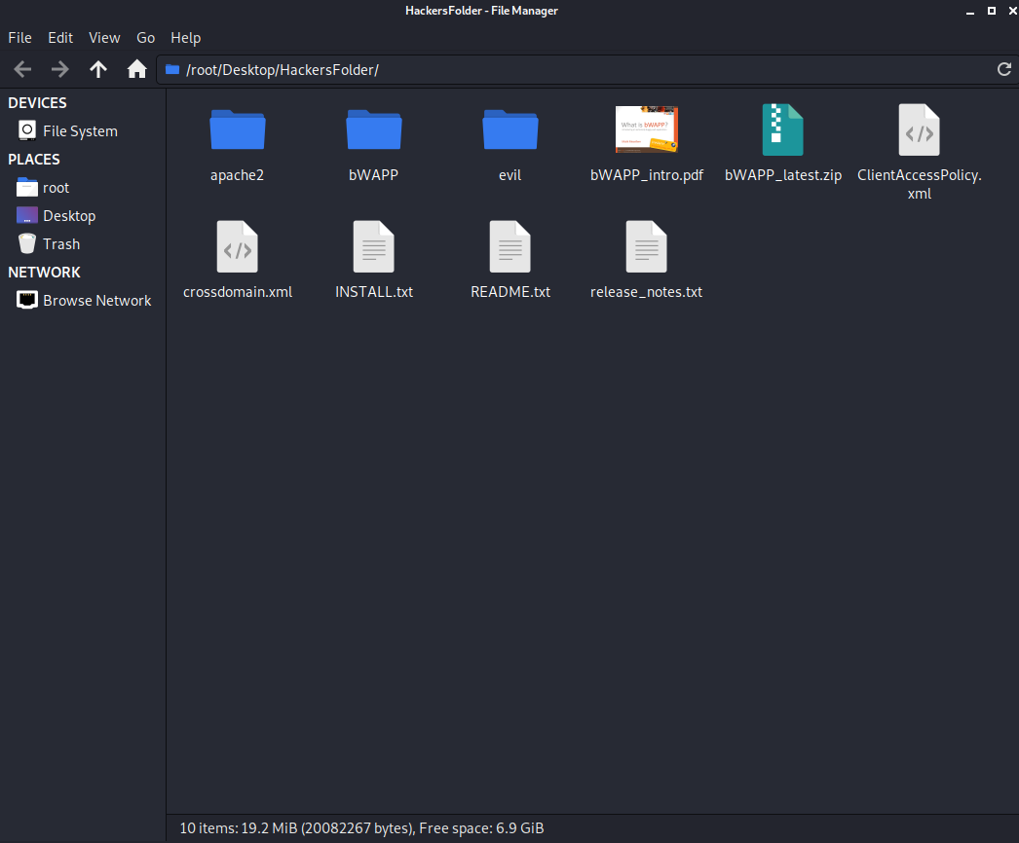
WEB Defacement
Setting up Lab
Now, you have downloaded it we will set-it up,
So first extract it from zip file and place it in desktop or any other folder, here I will place the extracted files in HackersFolder which I have specially maintained for this book, so go ahead and extract. You can extract it clicking right-click on zip file and click on extract here, all the files will be extracted, as you can see in that snapshot. The files also contain README.txt and tow main files bWAPP and apache2. you can go ahead and read that README.txt which contain installation instruction or you can just follow me. Look there the folder named bWAPP is where our website source code contain this is what from we have to deal with,

Slide 24
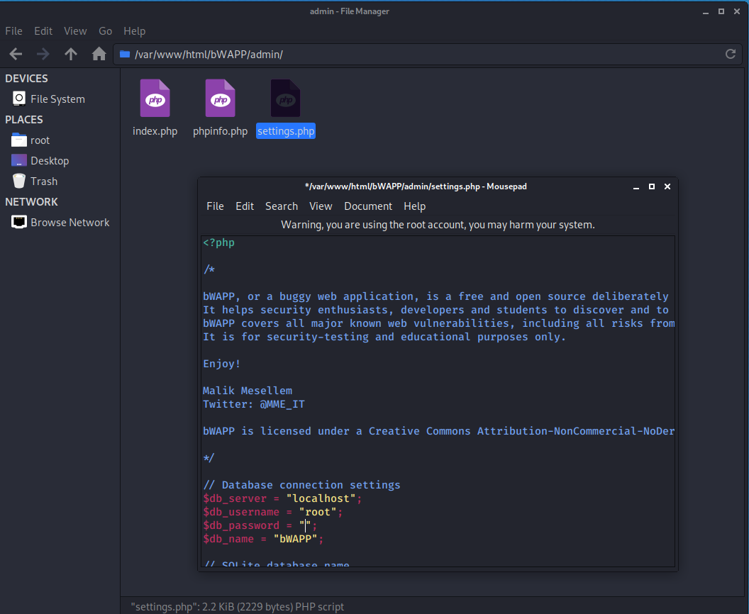
WEB Defacement
Setting up Lab
Next, we have to make some changes to the configuration file pf website, because it contains default passwords and username that we need to change according to our database username and passwords to do that open bWAPP folder there you will see admin/ folder which contains settings.php where we have to change values. Open that settings.php, there you’ll see $db_password = “bug” just remove that “bug” password and keep it blank, like
$db_password = “”. And that’s all the changes we need to make.

Slide 25
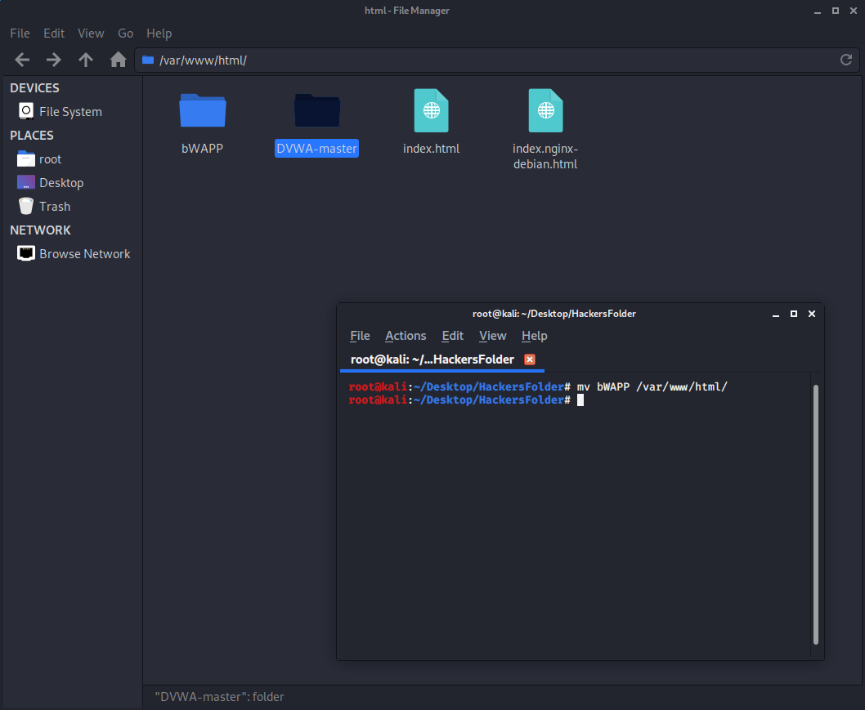
WEB Defacement
Setting up Lab
And the next step is we have to move the bWAPP folder to correct path or location so our browser could browse that application, so copy or cut that folder and move that to location
/var/www/html/
You can also use mv command or cp command to change it location, such as
cp –r bWAPP /var/www/html/
Or
mv bWAPP /var/www/html/
You can go and check at
/var/www/html/
The bWAPP folder will be present.
Now we need to change its permission so that we can work with it, just change its permission to 777 with chmod.
Which has covered in linux basics and we do we need that.

Slide 26
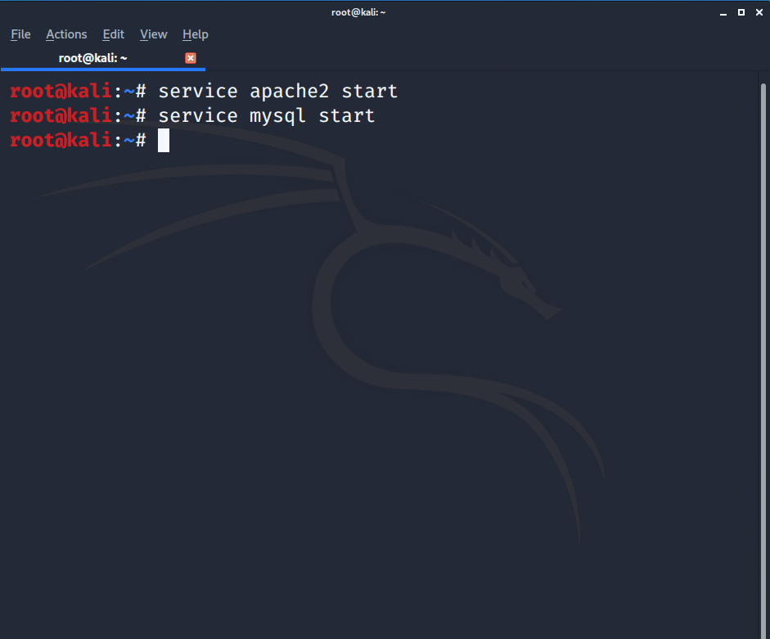
WEB Defacement
Setting up Lab
By default permissions are set to 731 we need to change it to 777.Change its permission with terminal using chmod command
root@kali~:/var/www/html# chmod 777 bWAPP
Now you can go and check out its permissions using
root@kali~:/var/www/html# ls –l
Now we are ready with changing permissions we need to install that website on our machine. The next is we need to start the apache server and MySQL database service.
To start these services open terminal and enter two commands
root@kali:~/# service apache2 start
root@kali:~/# service mysql start
If these commands doesn’t prompt any output means everything is going correctly. Usually services commands doesn’t prompt any output.

Slide 27
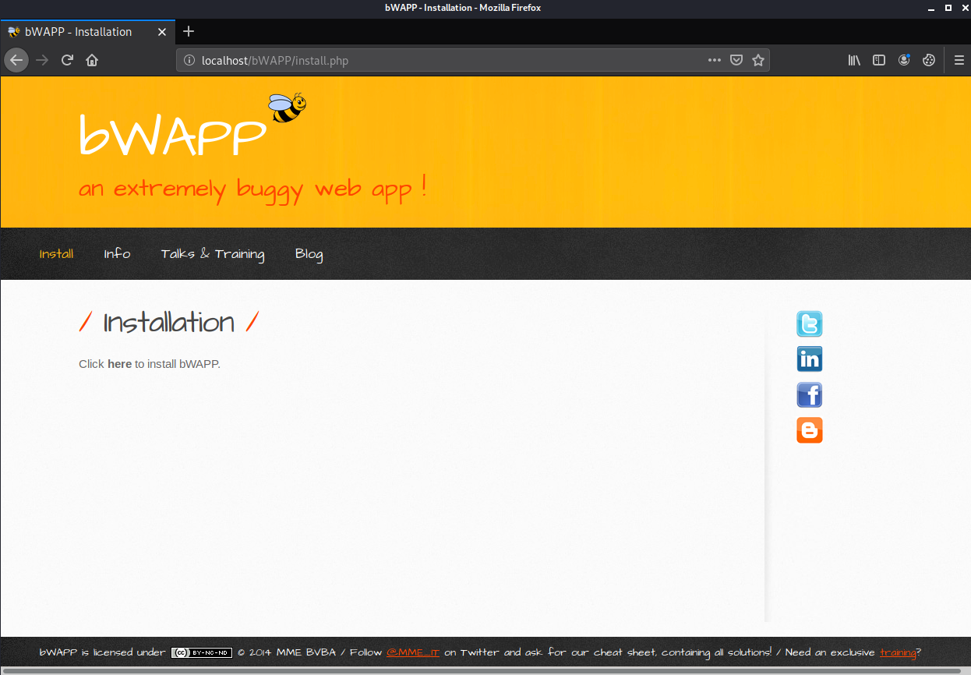
WEB Defacement
Setting up Lab
Not the next step to install website.
Go open browser Kali Linux comes with Firefox ESR.
Open it and enter the following url or type or go at address
localhost/bWAPP/install.php
Now you’ll be prompted with bWAPP installation page if you don’t get it means you went somewhere wrong or your operating system is not configured correctly, but if you got it then congratulation you going correct, now we’ll be seeing click here to install bWAPP.
Just click on here word and bWAPP will be installed.

Slide 28
Generating Wordlists
In early phase or chapter of Wi-Fi cracking and finding hidden content of website we saw that we used wordlists. So what are wordlists ?. Wordlist is the files contain thousands of , or lakhs or even millions of words or containing characters combinations which are use for burteforcing to find the hidden content or cracking passwords by trying each word contained in that wordlist, that’s why the size of wordlists and words are in huge numbers. Some wordlists also contain most popular password which are already cracked and are very common, and hence the size of this type of wordlists are in Gigabytes and are not preinstalled I any of Linux Distribution we hav to download it by our self kali Linux contains some of wordlists which are small in size but which are not reliable. We can also generate our own wordlists which we will be seeing in this section, we will be using tool called CRUNCH which is best tool to generate the wordlists which is console based. So then lets get started with the procedure to generate wordlists using crunch.

Slide 29
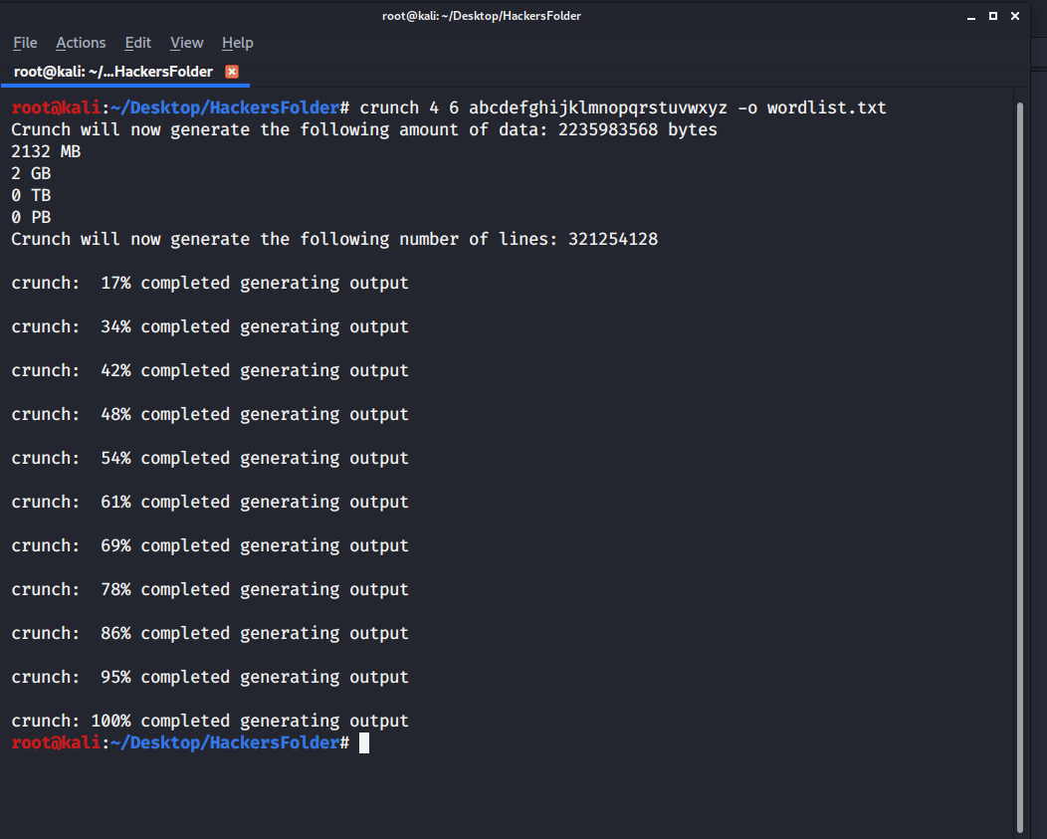
Generating Wordlists
Crunch
Go ahead and open a terminal where you want to save the generated wordlist, here I will be saving the wordlists in HackersFolder. Then next is type commands as I have entered such as
root@kali:~/Desktop/HackersFolder# crunch 4 6 abcdefghijklmnopqrstuvwxyz –o wordlist.txt
Here crunch keyword is use to start crunch tool followed by minimum length of words which I have taken 4 and 6 is maximum length of words to generate and the characters which I have entered abcdefghijklmnopqrstuvwxyz are the characters from which he wordlists will be generate and –o is the option which takes filename which you want to save the generated words in it. It will be created by its own you don’t need to create it manually, and press enter to generate the file containing words.

Slide 30
Generating Wordlists
Crunch
As you can see when you press enter it displays the size of file which will be generated, in my case it shows 2132 which is more 1 Gigabyte the reason the size is more because the length which I have entered is 4 to 6 , which normally password look like and I have entered all the characters starting form A to Z you can also add number if you want but remember the size will be again more its depends on you of which types of words you want to generate. And its also shows the process of completion . After hat you can go and check there will be file in my case it is wordlist.txt because I have given that name in command, when you open that it contains thousands of words generated according to the specification you entered in command, in my case the wrds generated is of minimum of 6l length and maximum of 6 characters and coains all the characters from A to Z.

Slide 31
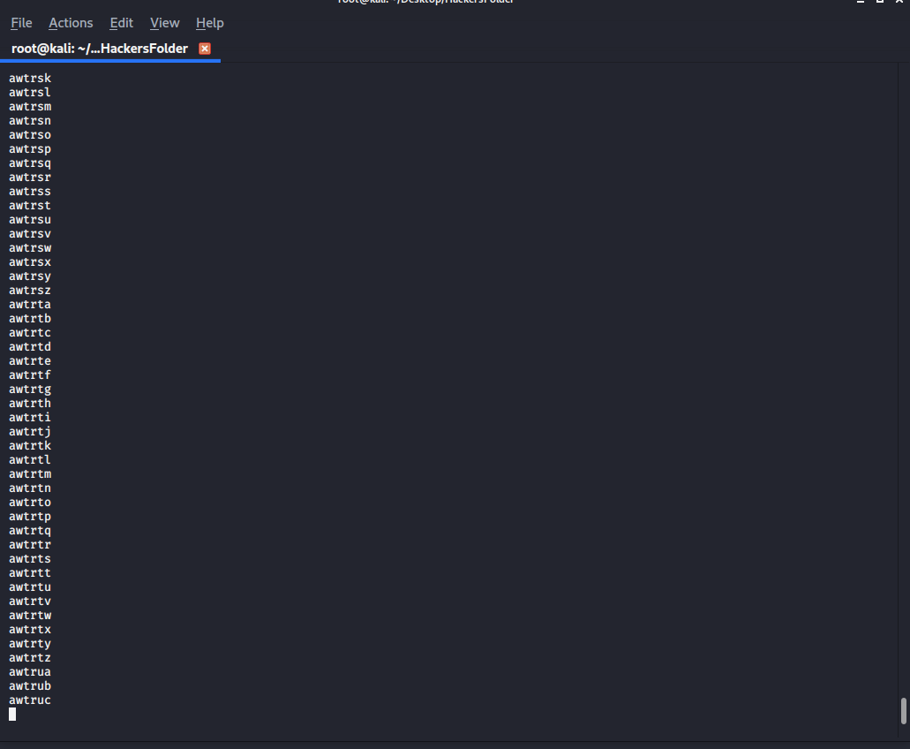
Generating Wordlists
Crunch
As you can see when you press enter it displays the size of file which will be generated, in my case it shows 2132 which is more 1 Gigabyte the reason the size is more because the length which I have entered is 4 to 6 , which normally password look like and I have entered all the characters starting form A to Z you can also add number if you want but remember the size will be again more its depends on you of which types of words you want to generate. And its also shows the process of completion . After hat you can go and check there will be file in my case it is wordlist.txt because I have given that name in command, when you open that it contains thousands of words generated according to the specification you entered in command, in my case the words generated is of minimum of 4 length and maximum of 6 characters and contains all the characters from A to Z.

